Slide 1



Submitting IGA/A Grant Competition Application
IGA/A GC Seminar
VSE, 30 September 2020
Ing. Martina Sušánková, Head of Office for Science and Research

Slide 2
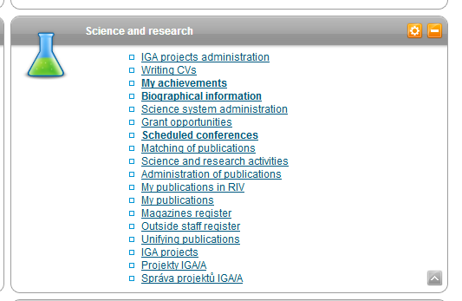
Opening an Application in InSIS (30 September 2020)

Slide 3
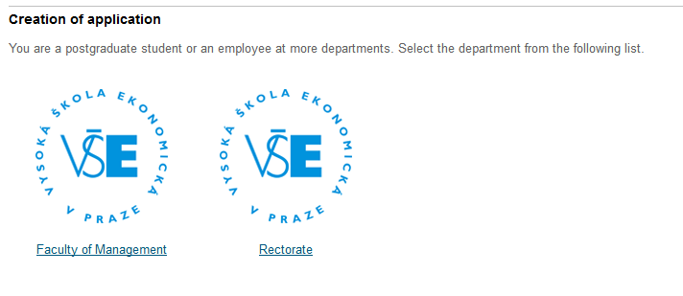
Creating an Application (a test application was created for the purposes of this seminar – testing on 23 September 2020)

Slide 4
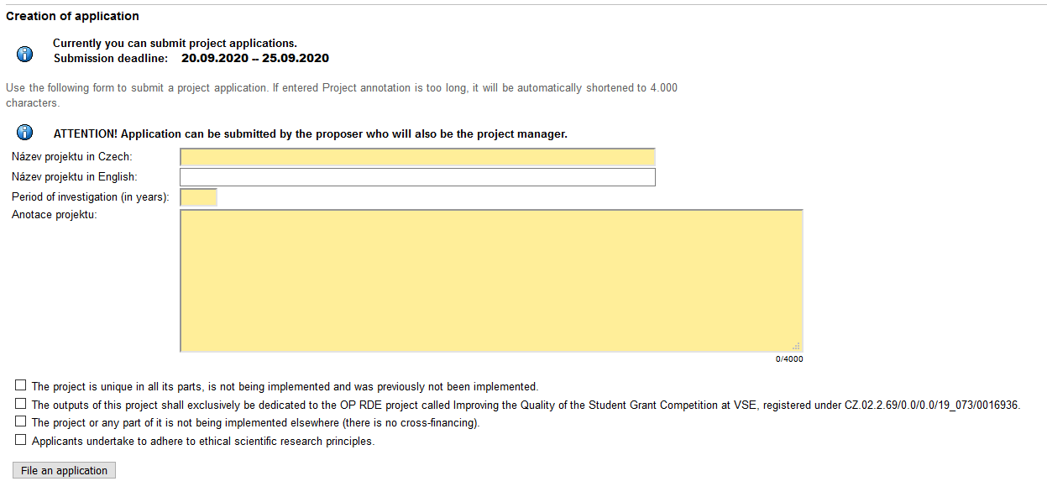
Creating an Application

Slide 5
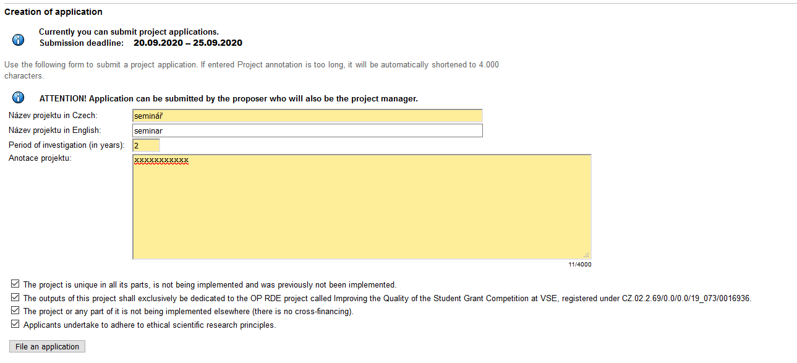

Creating an Application

Slide 6
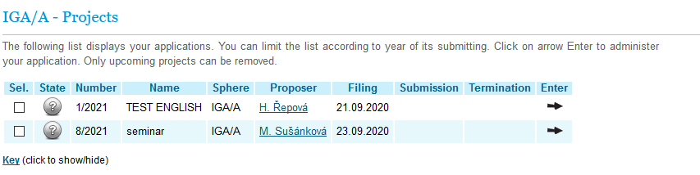
Application Status after the Application was Created
Administering the Application

Slide 7
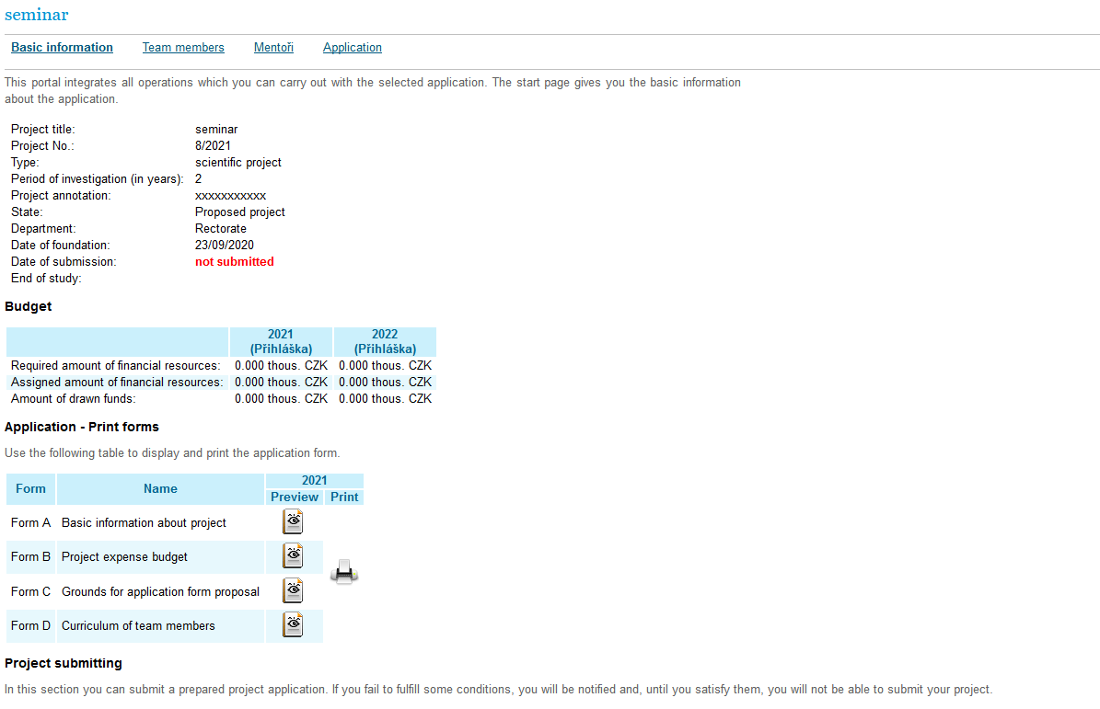

Basic Information

Slide 8
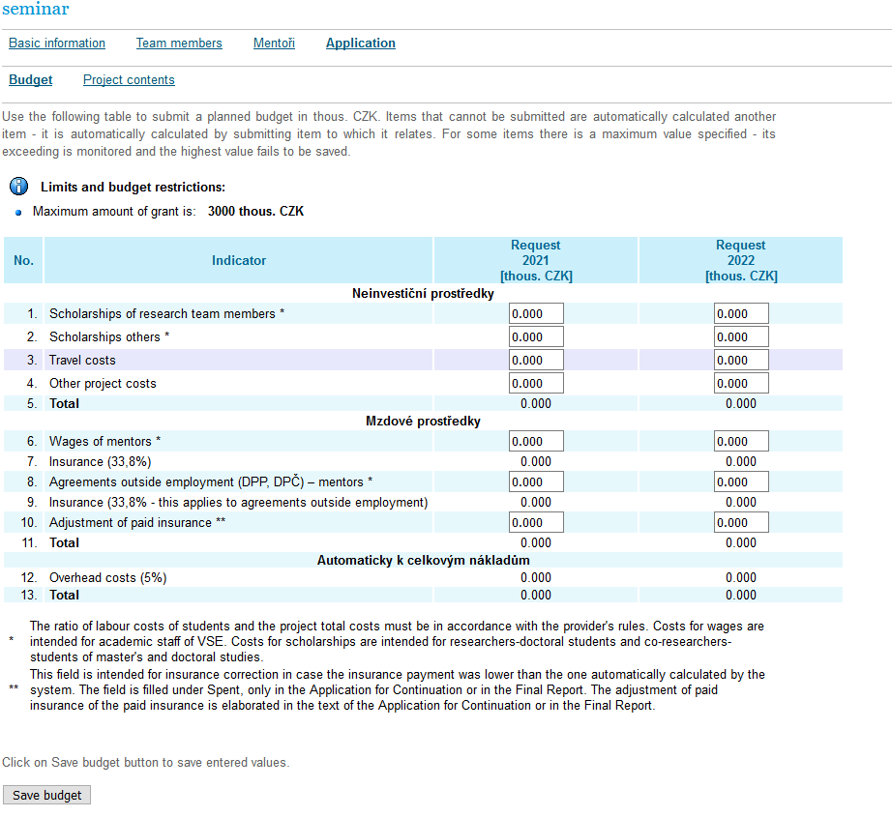

Application - Budget

Slide 9
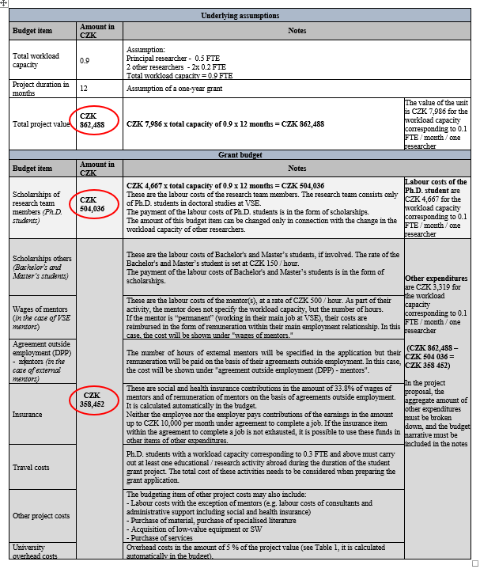

Annex to Rules – IGA/A GC Application Guide (Table 2)

Slide 10
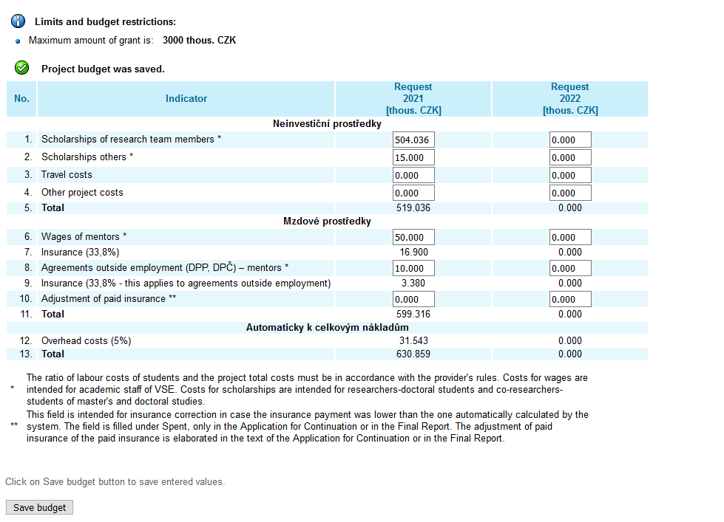

Application - Budget Preparation

Slide 11
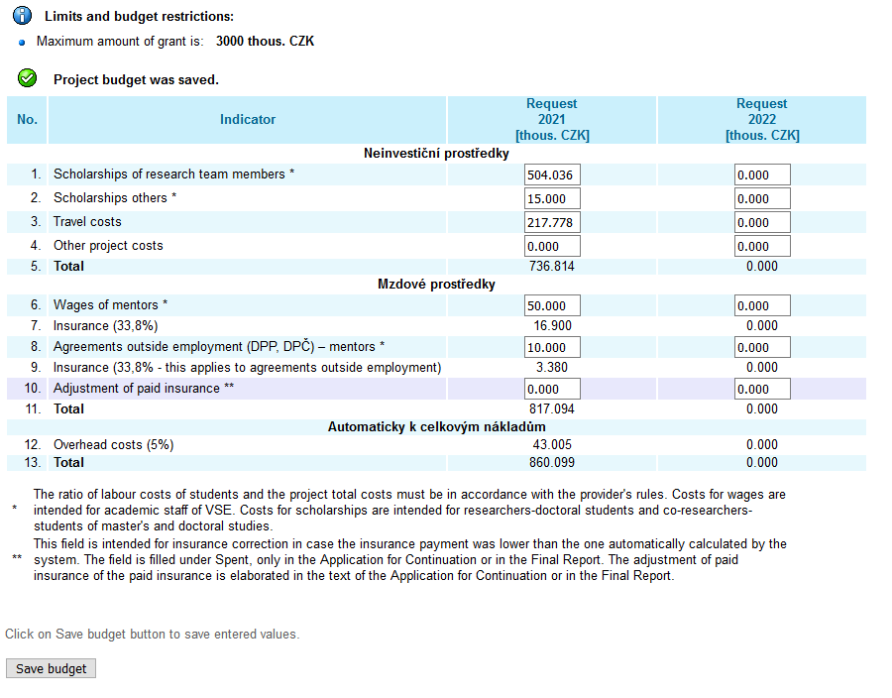
Application - Budget Preparation

Slide 12
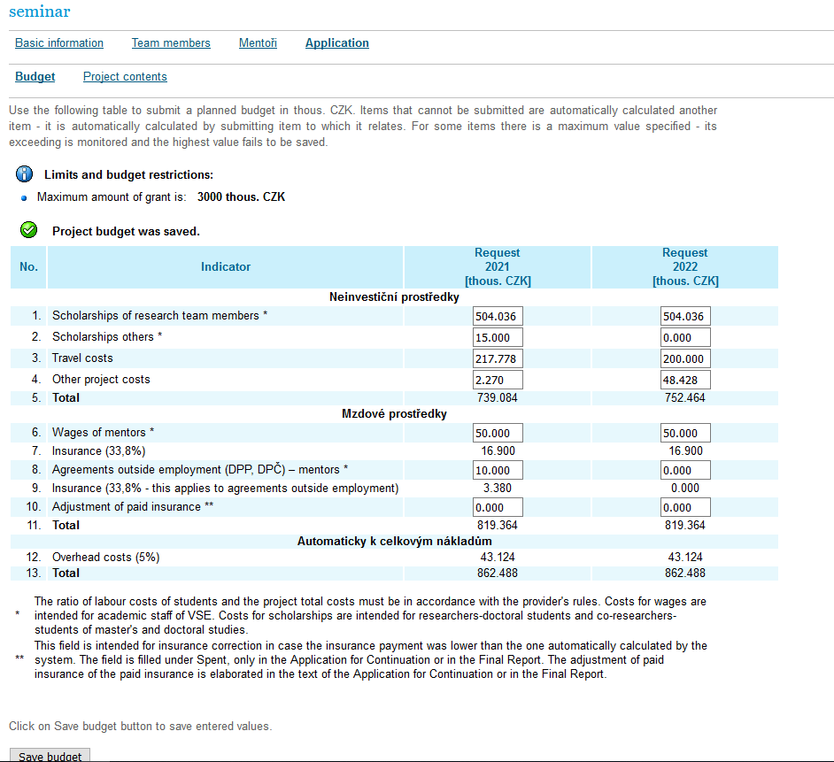

Application - Budget Preparation

Slide 13
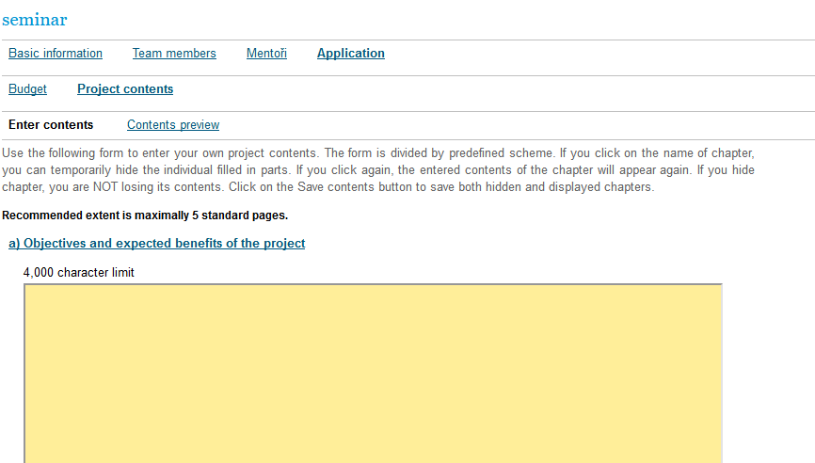

Application - Project Contents

Slide 14
Application - Project Contents
Objectives and expected benefits of the project
b) Analysis of the current state of knowledge
c) Project methodology
Project management: project schedule, involvement of individual researchers and mentors in the project
e) Expected project publication outputs
Up to the 10 most important publications of the research team over the past 5 years

Slide 15
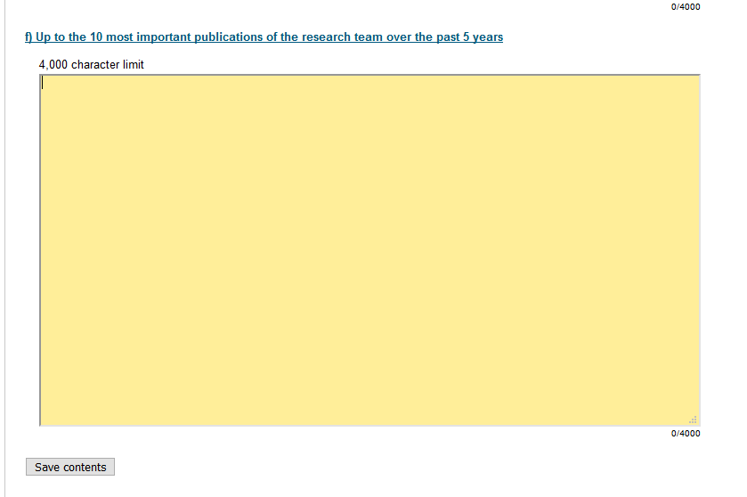

Application – Save Project Contents

Slide 16
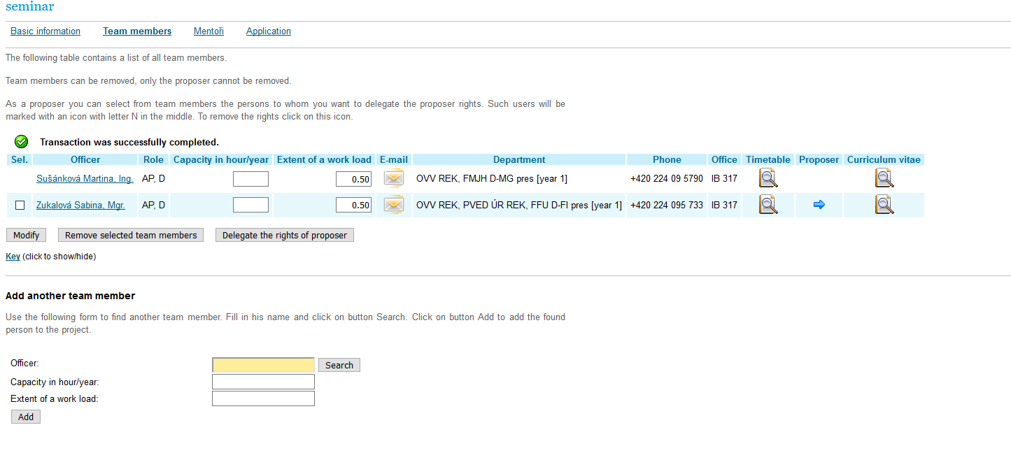
Application – CVs of Team Members

Slide 17
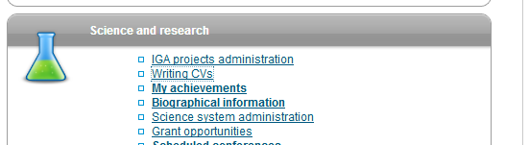

Writing CVs (to be created by each team member as well as each mentor)

Slide 18
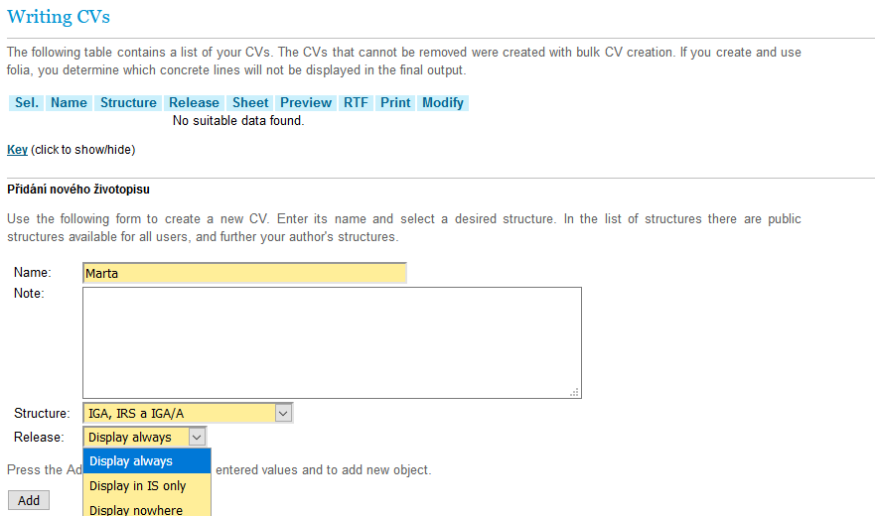

Writing CVs – Creating CVs

Slide 19
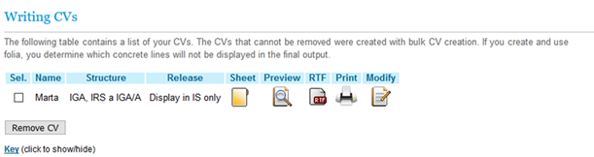

Processing CVs

Slide 20
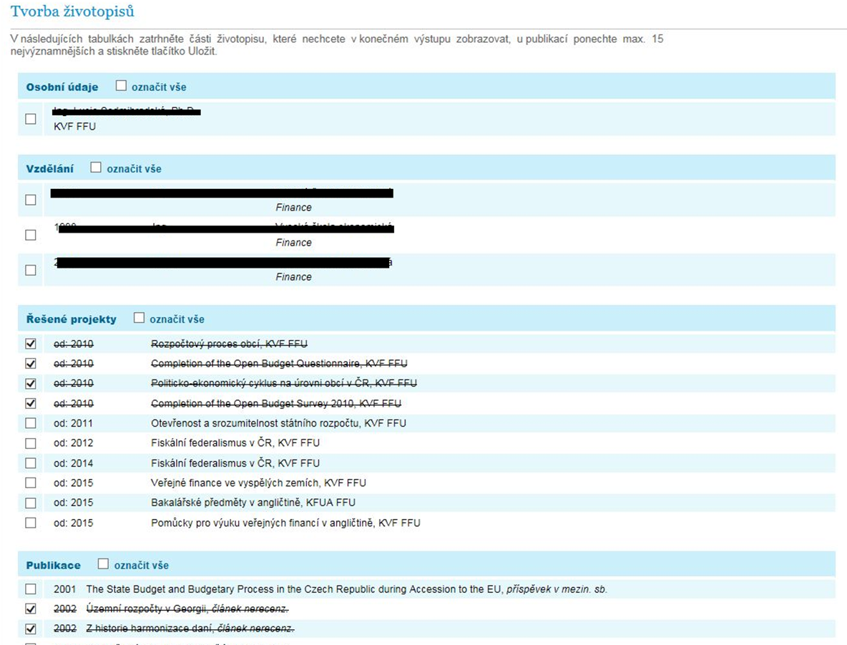
Processing CVs - Sheet

Slide 21


Application - Completion

Slide 22
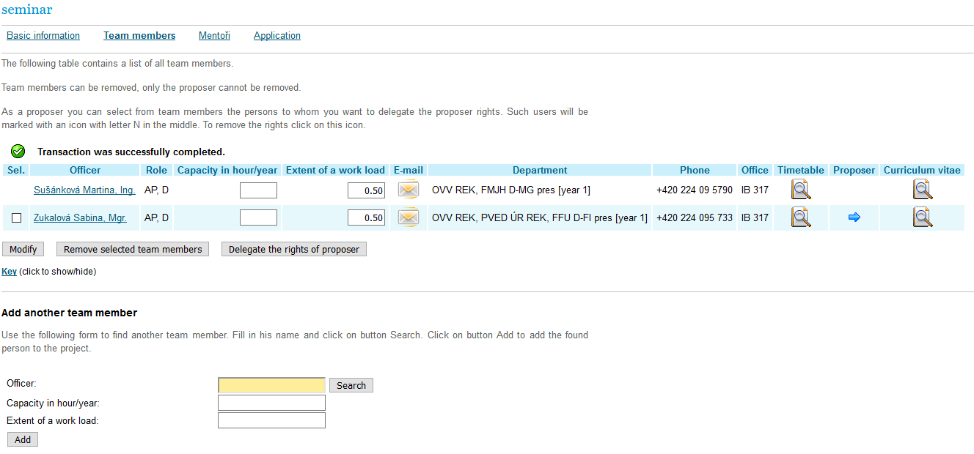

Application – Team Members

Slide 23
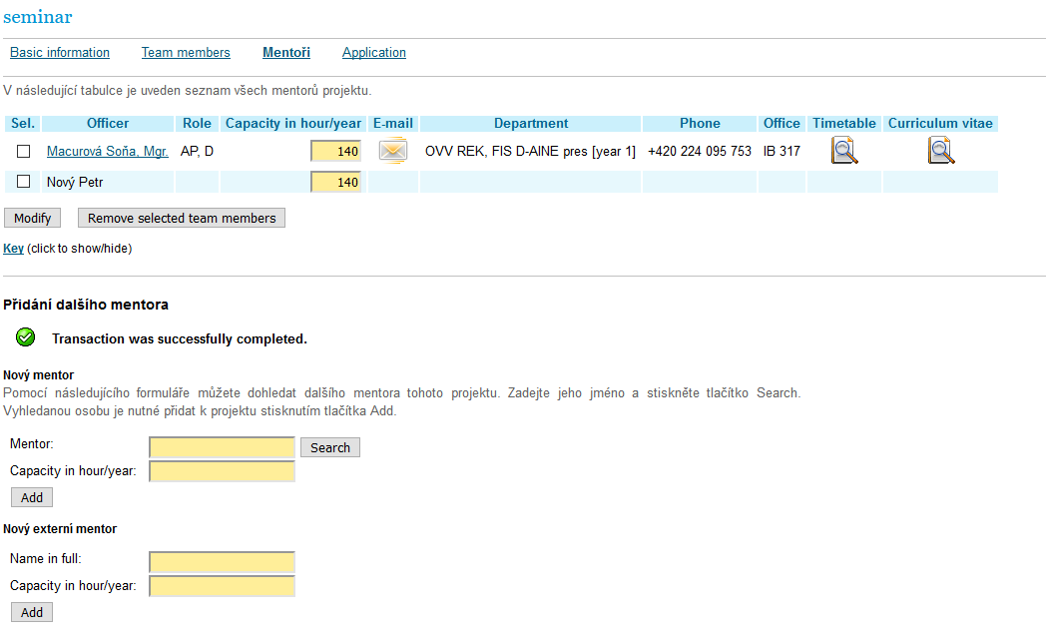
Application - Mentors

Slide 24
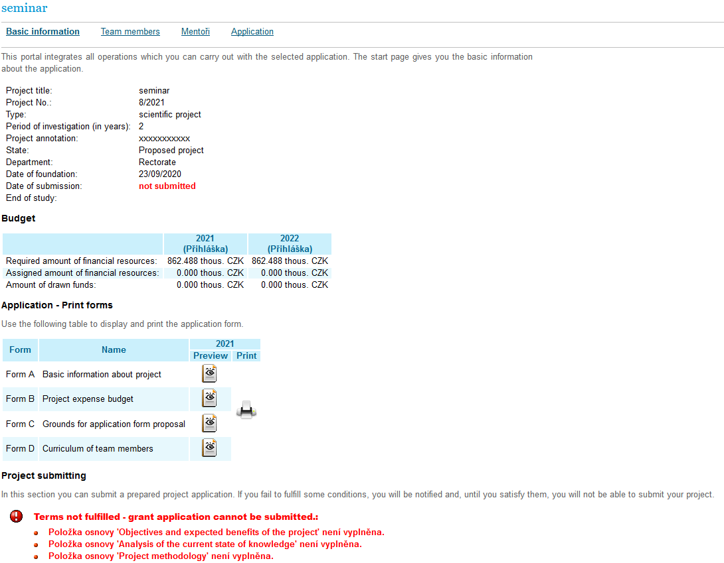

Basic Information / Print Forms - Preview/ Print

Slide 25
The grant application is submitted through an OSR worker administrating IGA/A GC (hereinafter referred to as the “administrator”). At the same time a paper copy of the application is also submitted to the administrator, which must be signed by the principal researcher and must include signed CVs of all members of the proposing team.
The Project Card is part of the grant application and its form is available at the OSR website under IGA/A GC https://science.vse.cz/science-research-support/grant/forms/.
All conditions of competition are available at OSR:
https://veda.vse.cz/podpora-vedy/granty/grantova-soutez-iga-a/
https://science.vse.cz/science-research-support/grant/iga-a-grant-competition/

Slide 26

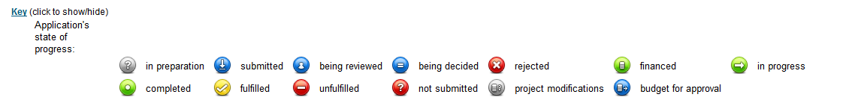
Submitted Project / Application’s State of Progress

Slide 27
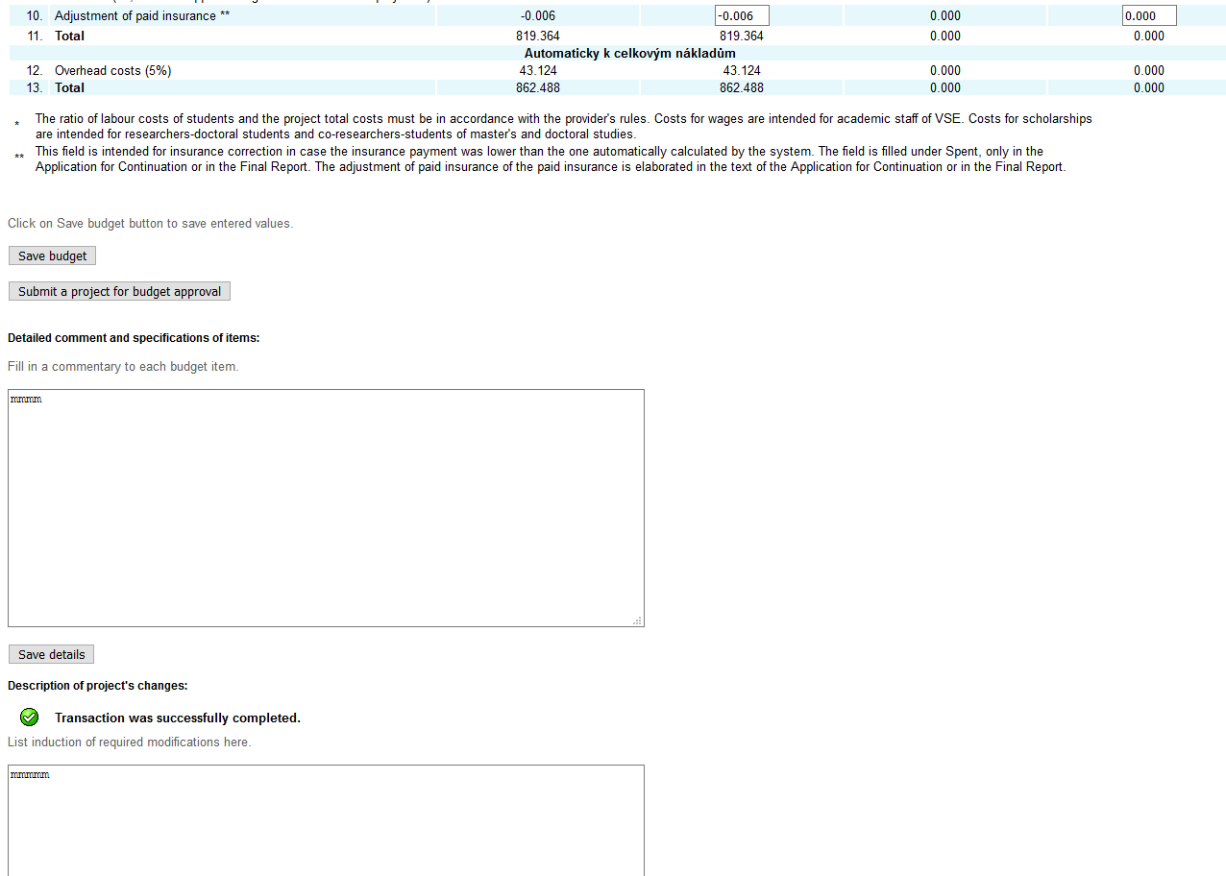


Project Proposal Adjustment

Slide 28
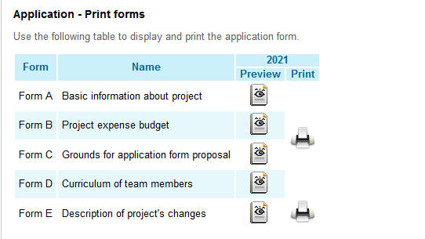
Project Proposal Adjustment

Slide 29
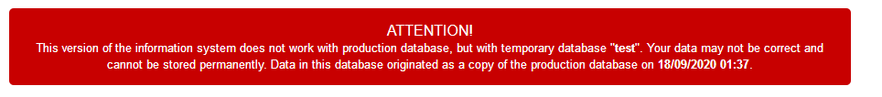
InSIS-test / the possibility to test the submission of an application proposal
https://insis-test.vse.cz/

Slide 30
Thank you for your attention

