Slide 1
Submitting IGA/A Grant Competition Application
Mgr. Sabina Zukalová
Office for Science and Research
IGA/A GC Seminar
VSE, 8 September 2021

Slide 2
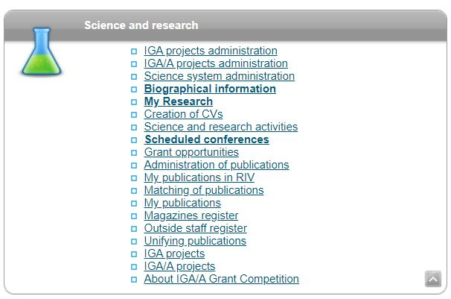
Opening an Application in InSIS (6 September 2021)

Slide 3
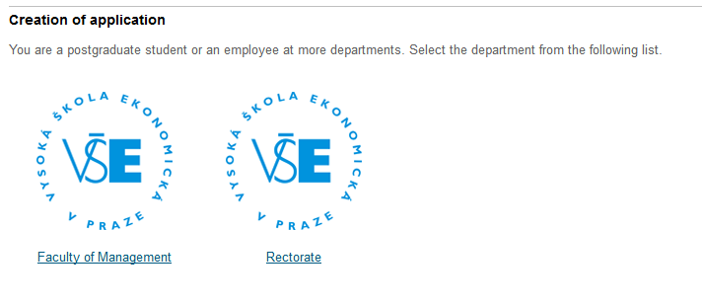
Creating an Application
(a test application was created for the purposes of this seminar – testing on 17 August 2021)

Slide 4
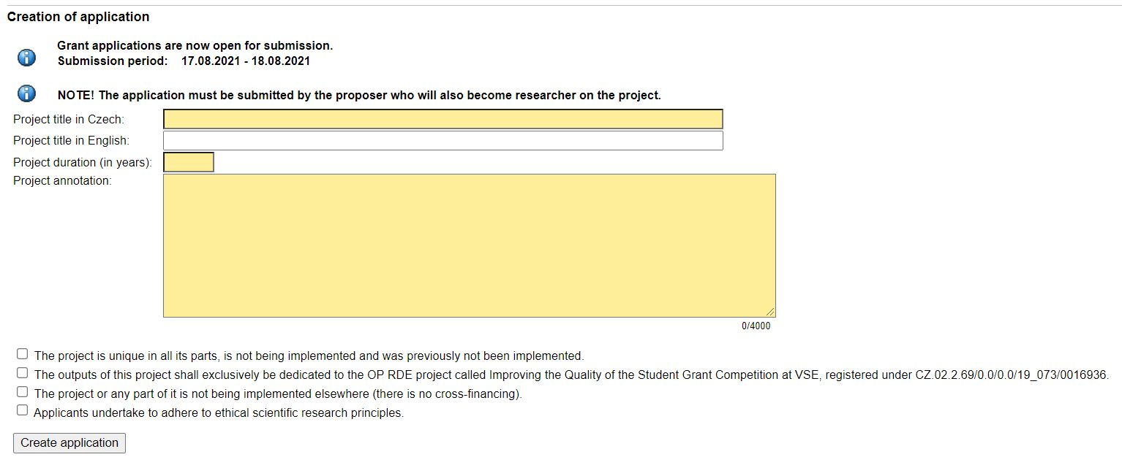
Creating an Application

Slide 5
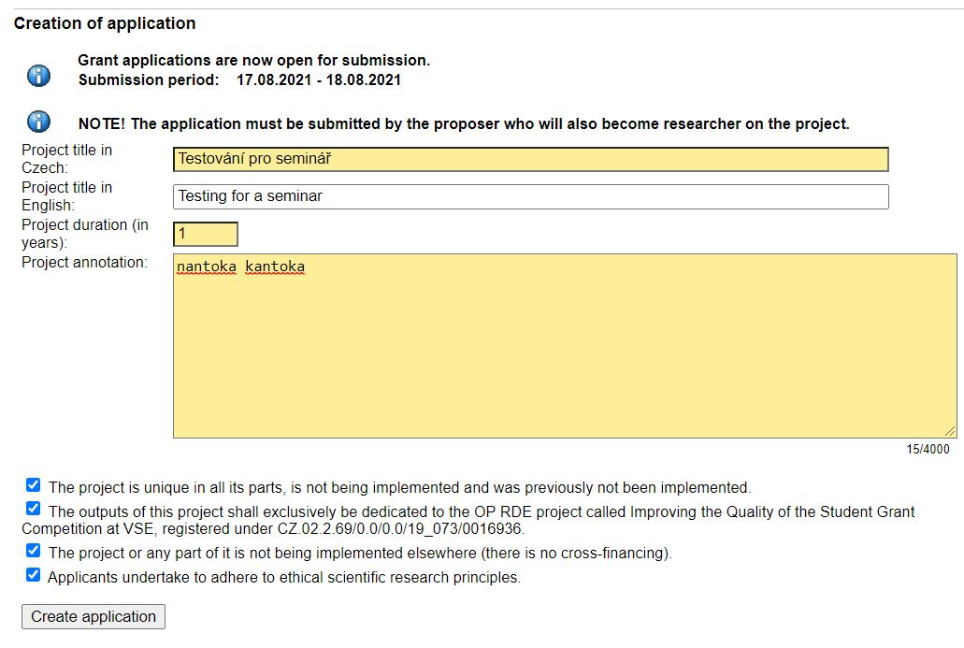
Creating an Application

Slide 6
Application Status after the Application was Created Administering the Application

Slide 7
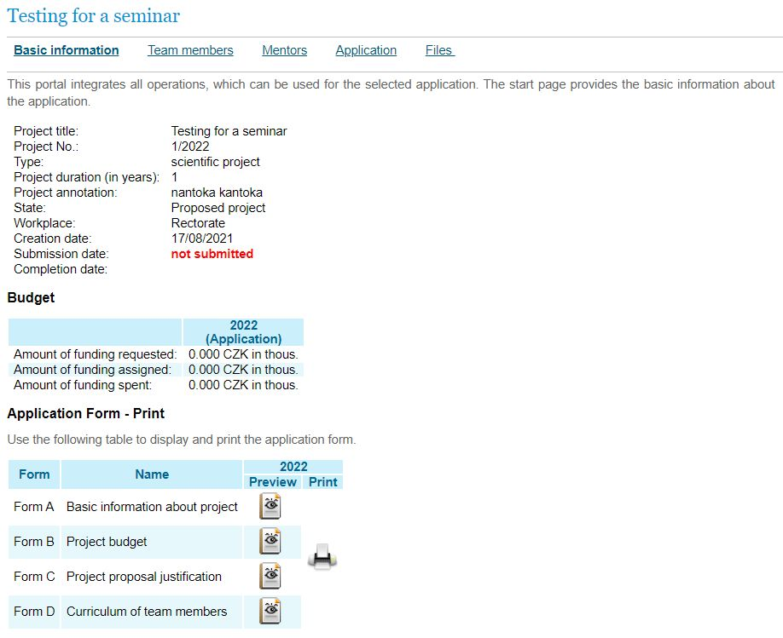
Basic Information

Slide 8
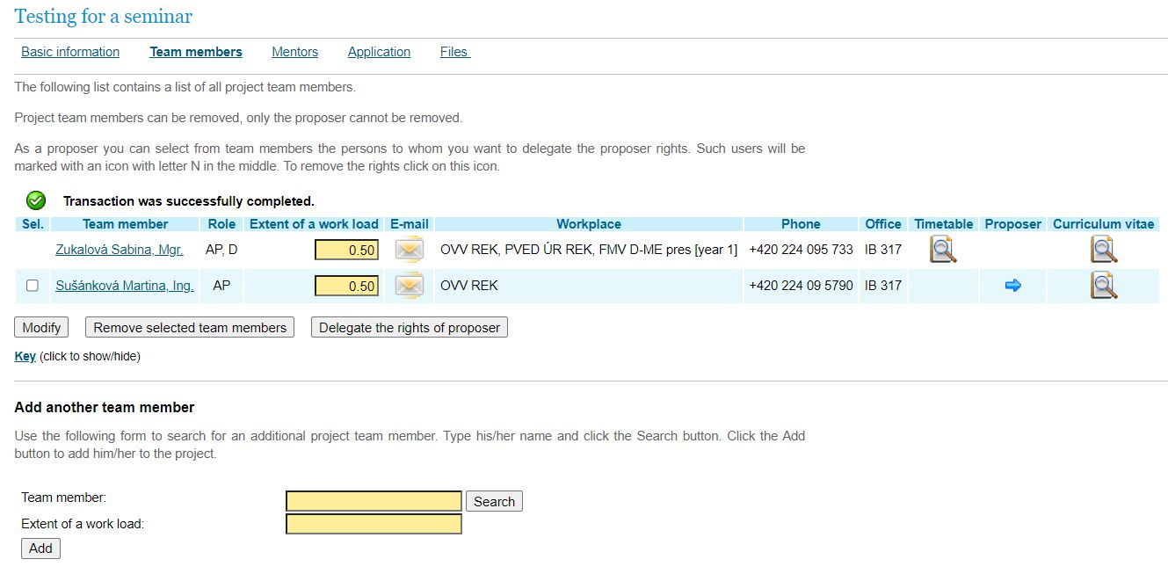
Application – Team Members

Slide 9
Application – CVs of Team Members

Slide 10
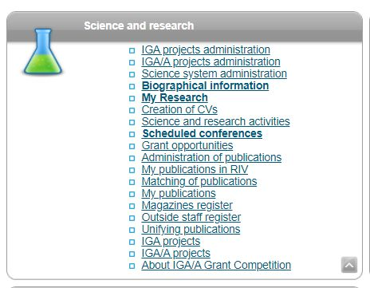
Creating CVs (to be created by each team member as well as each mentor)

Slide 11
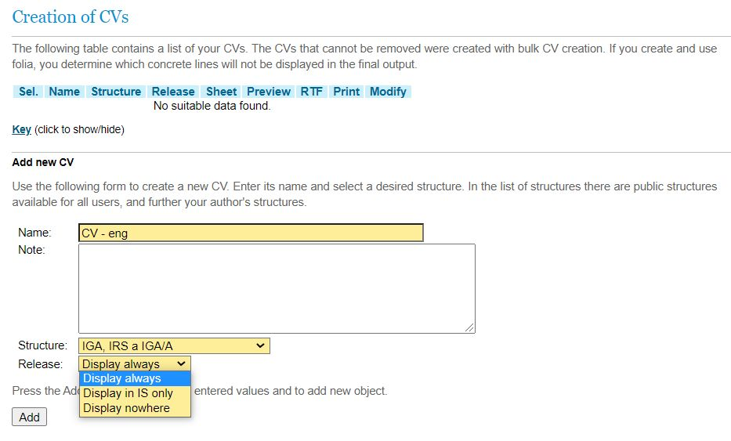
Creating CVs

Slide 12
Processing CVs

Slide 13
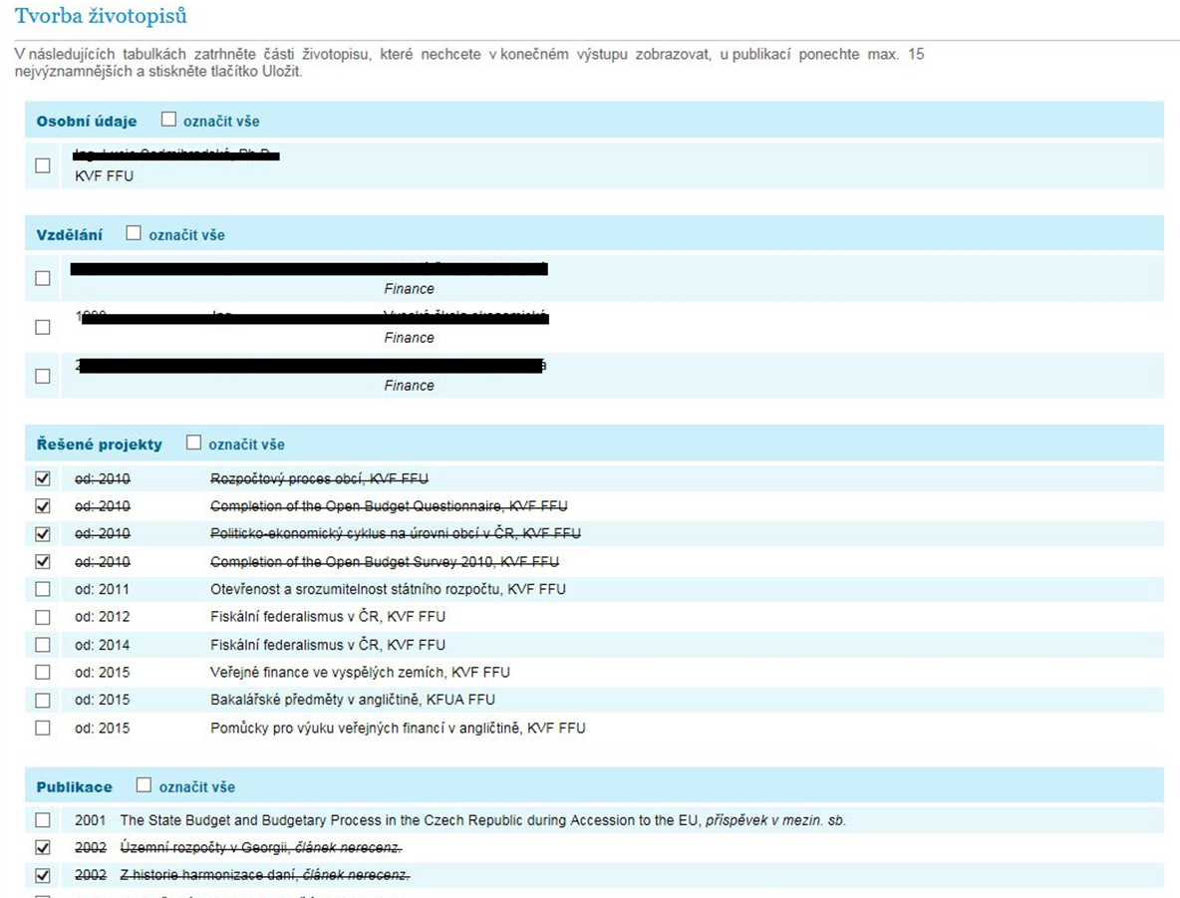
Processing CVs - Sheet

Slide 14
Application - Completion

Slide 15
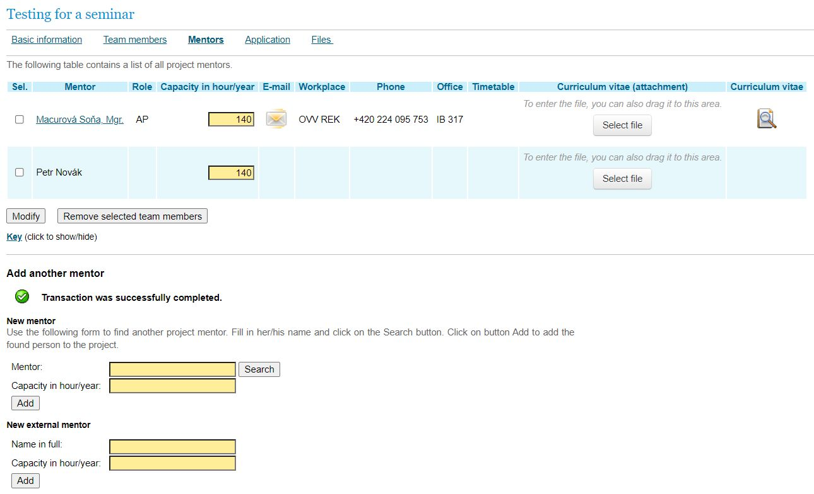
Application - Mentors

Slide 16
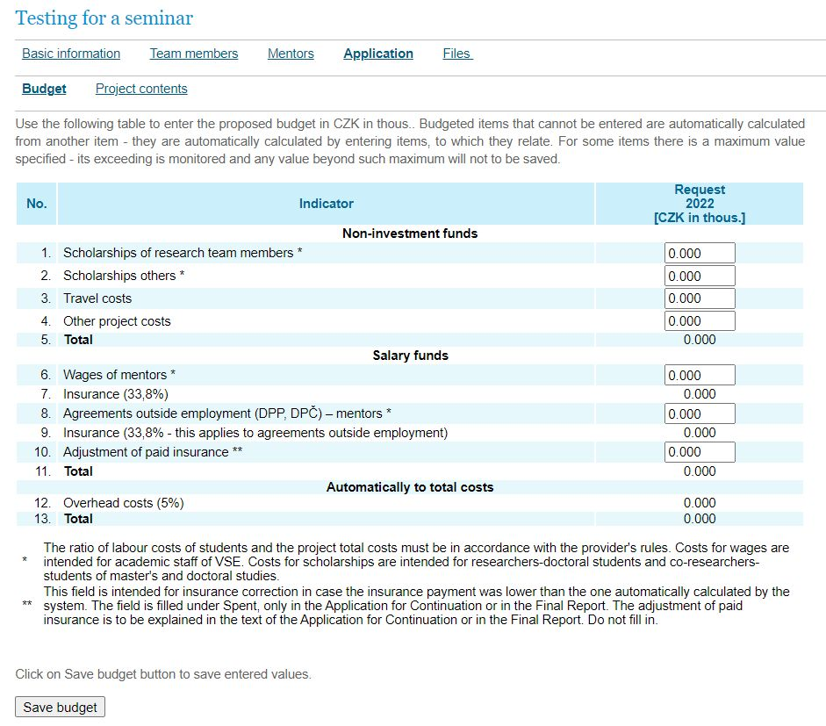
Application - Budget

Slide 17
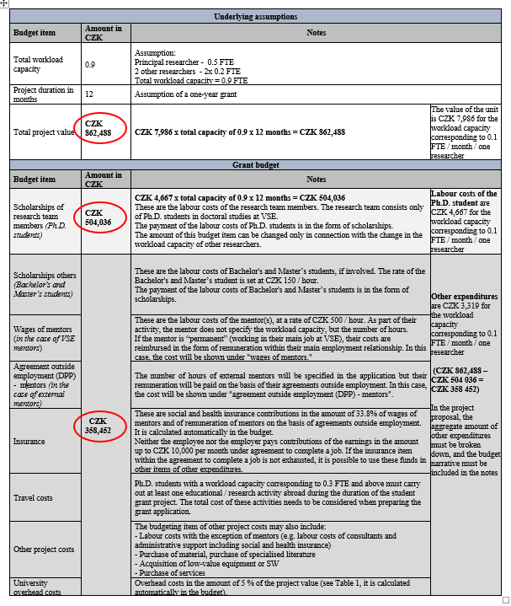
Annex to Rules – IGA/A GC Application Guide (Table 2)

Slide 18
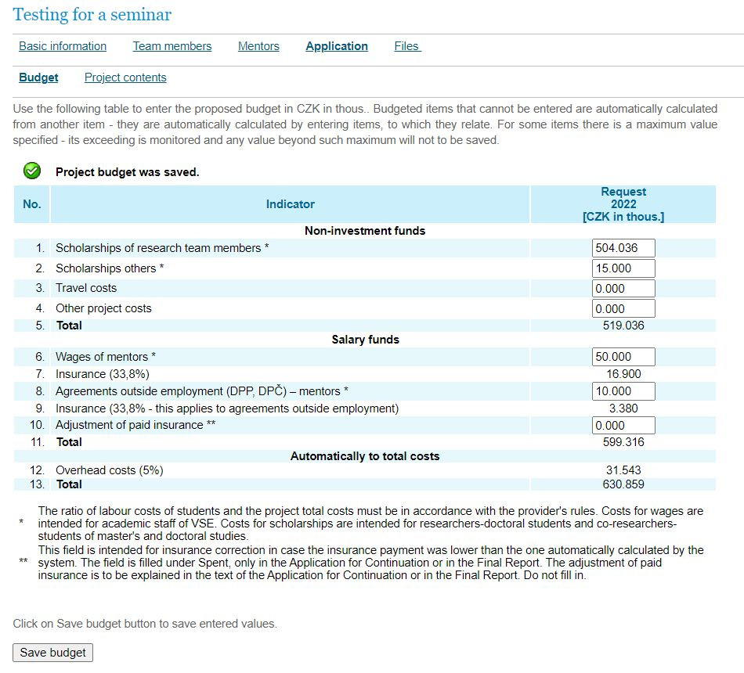
Application – Budget Preparation

Slide 19
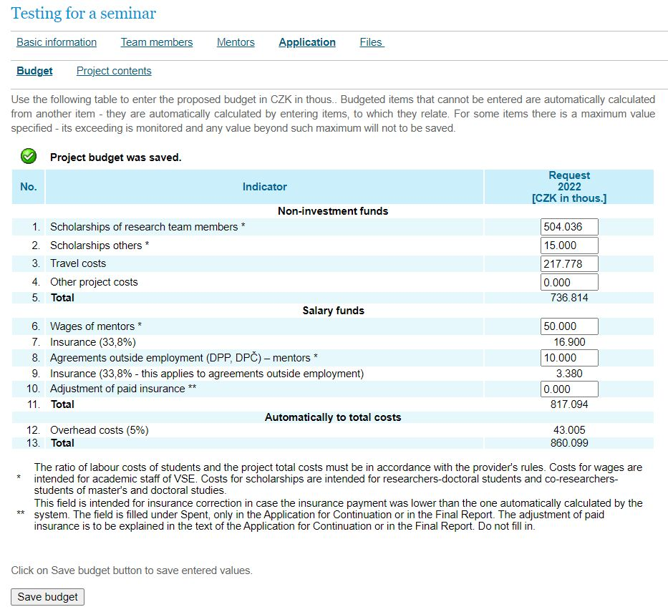
Application – Budget Preparation

Slide 20
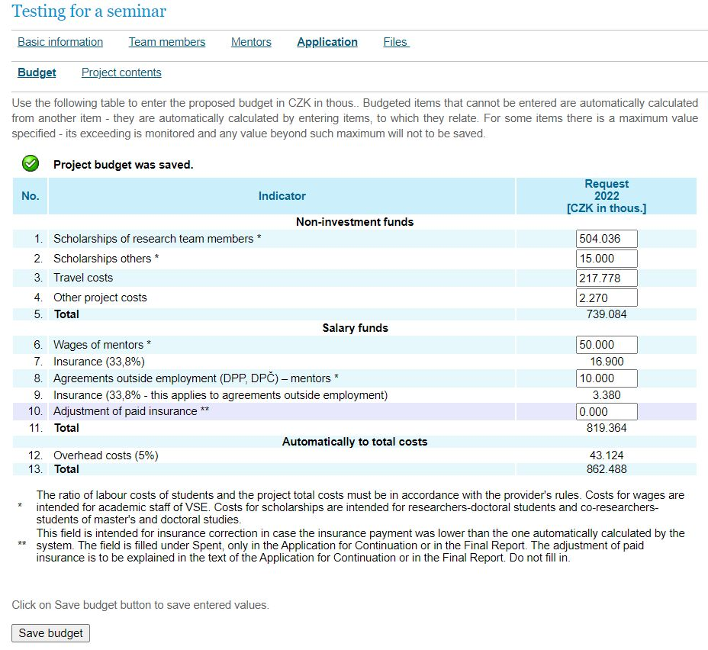
Application – Budget Preparation

Slide 21
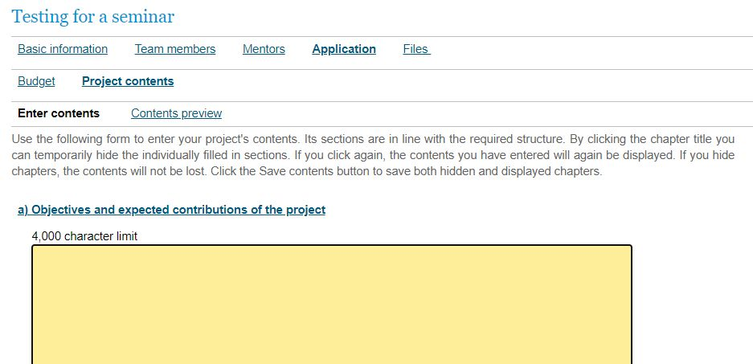
Application – Project Contents

Slide 22
Application – Project Contents
Objectives and expected benefits of the project
b) Analysis of the current state of knowledge
c) Project methodology
Project management: project schedule, involvement of individual researchers and mentors in the project
e) Expected project publication outputs
Up to the 10 most important publications of the research team over the past 5 years

Slide 23
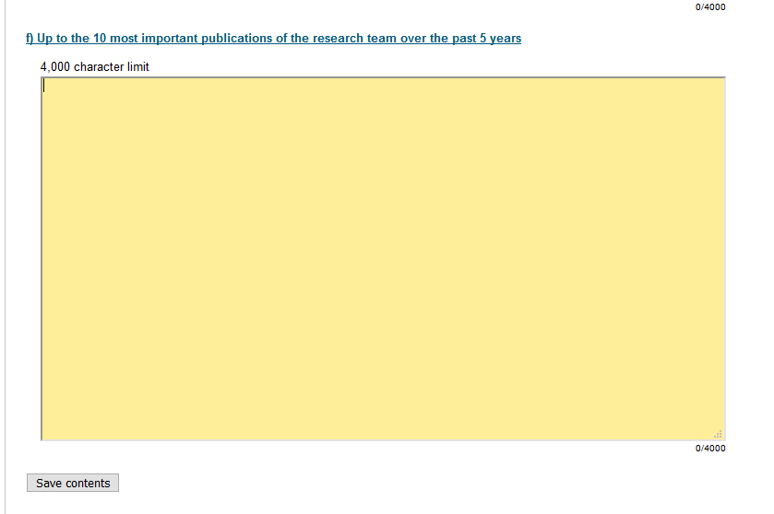
Application – Save Project Contents

Slide 24
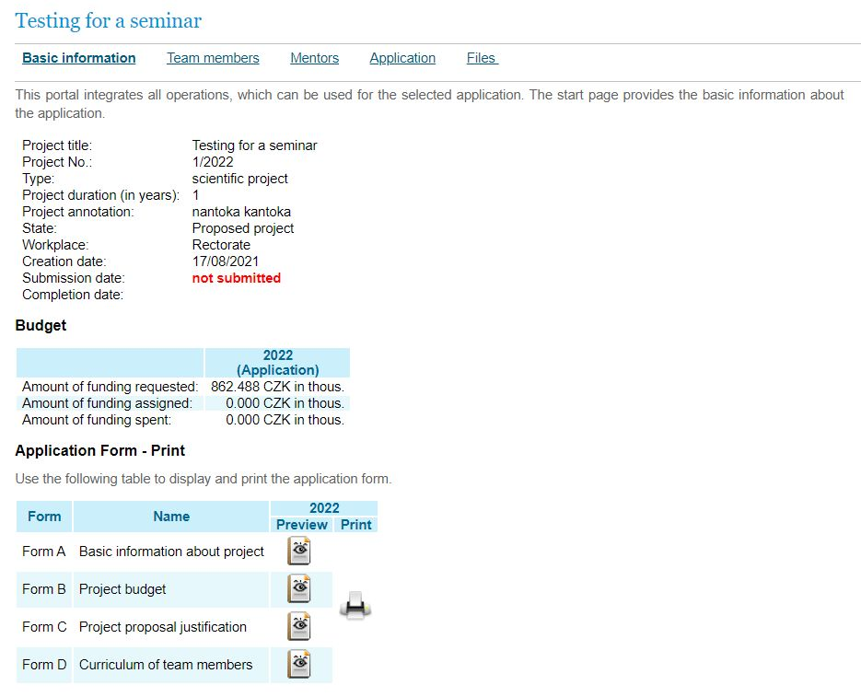
Basic Information / Print Forms - Preview/ Print

Slide 25
The grant application is submitted through an OSR worker administrating IGA/A GC (hereinafter referred to as the “administrator”). At the same time a paper copy of the application is also submitted to the administrator, which must be signed by the principal researcher and must include signed CVs of all members of the proposing team – including mentor.
The Project Card is part of the grant application and its form is available at the OSR website under IGA/A GC https://science.vse.cz/science-research-support/grant/forms/.
All conditions of competition are available at OSR:
https://veda.vse.cz/podpora-vedy/granty/grantova-soutez-iga-a/
https://science.vse.cz/science-research-support/grant/iga-a-grant-competition/

Slide 26
Submitted Project / Application‘s State of Progress

Slide 27
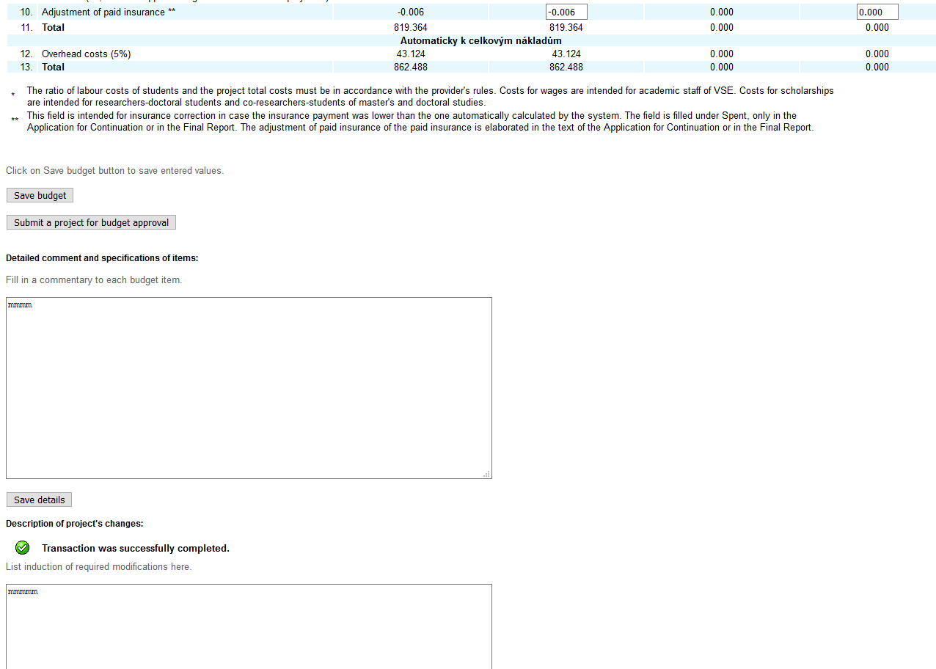
Project Proposal Adjustment

Slide 28
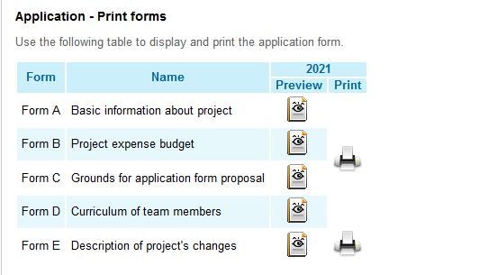
Project Proposal Adjustment

Slide 29
InSIS-test /
the possibility to test the submission of an application proposal
https://insis-test.vse.cz/

Slide 30
Thank you for your attention

